Slide 1


ALGORITHM TRADING
TSP- AI ML Fundamentals (Capstone Project)
Presented By:
A. MAHESWARAN – au810021114043
Guided By:
Dr.V.C.SATHISH GANDHI,M.E,MBA,PH.D.

Slide 2
OUTLINE
Problem Statement (Should not include solution)
Proposed System/Solution
Algorithm & Deployment
GitHub Link
Project Demo(photos / videos)
Conclusion
Future Scope
References

Slide 3
Problem Statement
Develop an algorithmic trading system that can automatically make buy, sell, or hold decisions in financial markets, based on predefined strategies and data inputs, with the aim of maximizing profit, minimizing risk, or achieving specific investment goals. The system should operate in real-time, process large volumes of data efficiently, and react to market changes instantaneously.

Slide 4
Proposed Solution
Monitor Your Algorithms Closely. Adjust Your Parameters. Effective Risk Management. Thorough Testing. Critical Results Review. Continuous Algorithm Improvement. Continuous Learning and Improvement.

Slide 5
Algorithm & Deployment
Algorithmic trading involves using computer programs and algorithms to automate the process of executing trades in financial markets. It aims to leverage mathematical models, statistical analysis, and high-speed data processing to make decisions that can capitalize on market inefficiencies. The goal is to maximize profits, minimize risks, and reduce the time taken to execute trades, often at a speed and frequency that would be impossible for humans to manage.

Slide 6
GitHub Link
https://github.com/Mahes4043/MAHESWARAN-A-810021114043-NAAN-MUDHALVAN-PROJECT

Slide 7
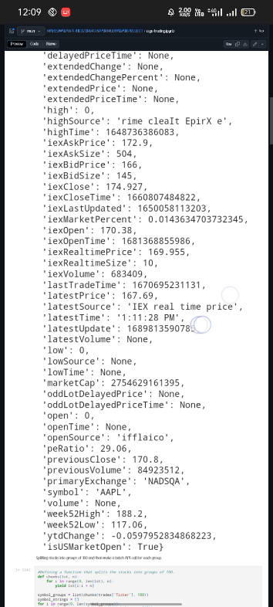
Project Demo(Recorded Video)

Slide 8
Conclusion
This work presented an overview of the construction of an automated trading system based on the required algorithms and hardware implementations. With respect to the algorithms, we began by dividing them into technical and textual analysis-based systems. We introduced the most problematic and valuable research areas in subdivisions of these two types, in which the statistical method PST, machine learning applications and textual analysis were highlighted. Because competition in today’s trading has increasingly high demands for speed, we also discussed the field of HFT, where hardware acceleration is required to achieve extremely low system delays. We also noticed that a number of problems remain to be solved and certain areas still in their therefore, further studies are required. We hoped that this paper could provide insights to researchers and practitioners about the various approaches to current trading system designs as well as inspiration for their related research.

Slide 9
Future Scope
As financial market is heavily correlated with various sources of information, a research direction. Lies on the system fusion for multi-information processing. An integrated EIS is aimed at fulfilling the intelligent decision-making with as much as possible useful information taken into consideration. In order to meet the real-time trade demand, dedicated hardware is to be implemented to ensure accelerated computation and secure communication in a real-time manner. Meanwhile, the system will also be improved by increased sophistication in detailed subarea, including the development of more sensitive indicators, fine-grained analytical methods in extraction etc. In future, for the purpose of data safety, techniques such as network encryption security should therefore be further explored and exploited.

Slide 10
References
1. Project Github link, Dr.V.C.Sathish Gandhi, 2024
2. Project video recorded link (youtube/github),Dr.V.C.Sathish Gandhi, 2024
3. Project PPT & Report github link, Dr.V.C.Sathish Gandhi , 2024

Slide 11
THANK YOU

